Slide 1

Stock Market Prediction Using Machine Learning
Presenter: Ajmal Amir
Stock Market Prediction Using Machine Learning Authors: Abdulhamit Subasi, Faria Amir, Kholoud Bagedo, Asmaa Shams, Akila Sarirete Year: 2021 Published in: Procedia Computer Science Affiliation: Department of Computer Science, College of Engineering, Effat University, Jeddah, 21478, Saudi Arabia E-mail: absubasi@effatuniversity.edu.sa

Slide 2
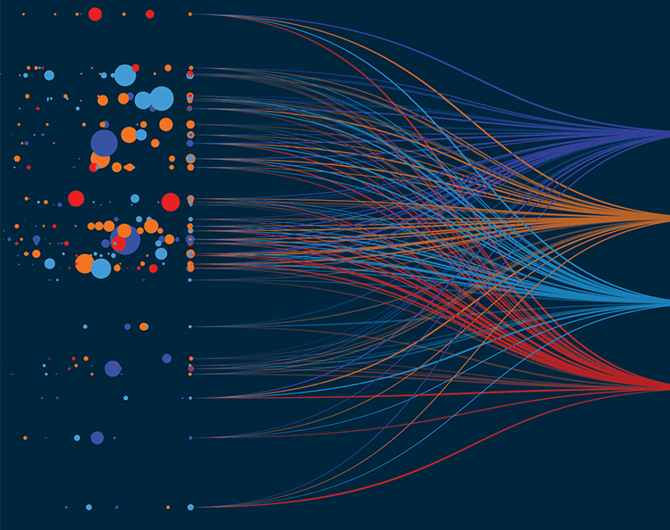
Problem Statement
What problem are we tackling?
Stock market price prediction is a challenging problem due to the volatile nature of financial markets. This project aims to develop a machine learning model to predict stock trends using historical price data.

Slide 3

Dataset
Data Source: Yahoo Finance API Dataset Link: https://finance.yahoo.com/quote/NFLX/history/
Dataset API: import yfinance as yf
stock_data = yf.download("NFLX", start="2015-01-01", end="2025-01-01")
Features Used:
Date
Open Price
High Price
Low Price
Closing Price
Volume

Slide 4

Why is this important?
Helps investors make data-driven decisions.
Predicting market trends provides insights into potential investment opportunities.
Machine learning techniques can help improve the accuracy of traditional forecasting models.

Slide 5

Survey on Related Work
Primary Paper:
Title : "Stock Market Prediction Using Machine Learning"
Authors: Abdulhamit Subasi, Faria Amir, Kholoud Bagedo, Asmaa Shams, Akila Sarirete
Year: 2021
Published in: Procedia Computer Science
Why? This paper examines various machine learning models and compares their performance in predicting stock market trends.

Slide 6

Survey on Related Work Conte…
Other Related Papers:
Title : "Time series forecasting of stock market using ARIMA, LSTM, and FB Prophet"
Authors: Asha Sunki, C. SatyaKumar, G. Surya Narayana, Vinith Koppera, Manish Hakeem
Year: 2024
Published in: MATEC Web of Conferences, ICMED 2024
Why? This paper compares ARIMA with other forecasting models, providing a strong basis for understanding traditional time-series forecasting.

Slide 7

Survey on Related Work Conte…
Title: "An efficient hybrid approach for forecasting real-time stock market indices"
Authors: Riya Kalra, Tinku Singh, Suryanshi Mishra, Satakshi, Naveen Kumar, Taehong Kim, Manish Kumar
Year: 2024
Published in: Journal of King Saud University - Computer and Information Sciences
Why this paper? It explores hybrid machine learning techniques for stock market forecasting, providing insights into combining different methods for better accuracy.

Slide 8

Method of Selected Paper
The paper implements traditional machine learning models, such as:
Linear Regression for trend analysis.
Support Vector Machines (SVM) for classification of stock movements.
Random Forest Regression for predicting future stock prices.
Uses historical price data to predict future stock movements.
Evaluation metrics: Mean Absolute Error (MAE), Root Mean Squared Error (RMSE).

Slide 9
Plan and Timeline
Phase | Task | Duration
Data Collection | Fetch historical stock data from Yahoo Finance | Week 1
Exploratory Data Analysis | Visualizing trends, feature engineering | Week 2
Model Implementation | Train Regression, SVM & Random Forest models | Week 3-4
Evaluation & Testing | Compare models, fine-tune hyperparameters | Week 5
Report Writing | Document findings and prepare slides | Week 6
Presentation | Finalize presentation and submit | Week 7

Slide 10

Expected Learning Outcomes
Understanding the limitations and effectiveness of stock prediction models.
Comparing traditional ML models such as regression, SVM, and Random Forest.
Learning about feature engineering and its role in financial modeling.
Gaining experience in evaluating and improving predictive models.

Slide 11
References
Sunki, Asha, et al. "Time series forecasting of stock market using ARIMA, LSTM, and FB Prophet." MATEC Web of Conferences, ICMED 2024, 2024.
Subasi, Abdulhamit, et al. "Stock Market Prediction Using Machine Learning." Procedia Computer Science, 2021.
Kalra, Riya, et al. "An Efficient Hybrid Approach for Forecasting Real-Time Stock Market Indices." Journal of King Saud University - Computer and Information Sciences, 2024.

Slide 12
End Of Proposal
GitHub Repo: https://github.com/ajmal-amir/MarketIQ.git

